Slide 1
renting a photo booth near Culver City
https://www.luckyfrogphotos.com/culvercityphotobooth.html
Notes:
https://www.luckyfrogphotos.com/culvercityphotobooth.html
https://drive.google.com/drive/folders/1BoYg4-HVD8HVYWgk4HoNSaNiO57ayxRe?usp=sharing
https://news.google.com/rss/search?q=videobooth
https://drive.google.com/drive/folders/1qt9pIrCMSukcoSDI8AMezRyzxAsiloJO?usp=sharing
https://drive.google.com/drive/folders/1xa7bCphon4tC73TLvf-S0nNzjAmubM2H?usp=sharing
https://drive.google.com/drive/folders/1uHGuQpZ0PPkI-1H74leIdko7hXIMXBO1?usp=sharing
https://drive.google.com/drive/folders/1KkFoaDUZUNADbDICj1O5sXpt5bhgFSOv?usp=sharing
https://drive.google.com/file/d/1t33hvFbsi4sSFSNdR8g74m5ACVKQUi0g/view?usp=sharing
https://drive.google.com/file/d/1pk3MIMgL3RwYAW_xASSBvH08mq0KTdLE/view?usp=sharing
https://docs.google.com/spreadsheets/d/1UEKt-AhBPgMDF33Mkd8itPlFO-t8kZR40ZvIgm27QZE/edit?usp=sharing
https://docs.google.com/spreadsheet/pub?key=1UEKt-AhBPgMDF33Mkd8itPlFO-t8kZR40ZvIgm27QZE
https://docs.google.com/spreadsheets/d/1UEKt-AhBPgMDF33Mkd8itPlFO-t8kZR40ZvIgm27QZE/pubhtml
https://docs.google.com/spreadsheets/d/1UEKt-AhBPgMDF33Mkd8itPlFO-t8kZR40ZvIgm27QZE/pub
https://docs.google.com/spreadsheets/d/1UEKt-AhBPgMDF33Mkd8itPlFO-t8kZR40ZvIgm27QZE/view
https://docs.google.com/forms/d/1Vb0GfGRNs9E82XCbgjgh-WRZnYukVD6et0LuUwh-ISQ/edit?usp=sharing
https://docs.google.com/drawings/d/1UV6JJowxl5lU1TsgQ-eztXNbpWq6SfvrghbzS9dD6Xo/edit?usp=sharing
https://drive.google.com/file/d/1Ub_baxN1yIKa7z6PHbWKiQ5Hv3QmkYdb/view?usp=drivesdk
https://sites.google.com/view/culvercityphotoboothrentals/home
https://docs.google.com/document/d/12yCBV9QYnLrYezSh-OGexx2zeqpDxGvxIpQ-58wzC54/edit?usp=sharing
https://docs.google.com/document/d/12yCBV9QYnLrYezSh-OGexx2zeqpDxGvxIpQ-58wzC54/pub
https://docs.google.com/document/d/12yCBV9QYnLrYezSh-OGexx2zeqpDxGvxIpQ-58wzC54/view
https://docs.google.com/presentation/d/1VYNJuHT3tDFexIO9HXg2FurP4rSPntnaHDT75nVkkEM/edit?usp=sharing
https://docs.google.com/presentation/d/1VYNJuHT3tDFexIO9HXg2FurP4rSPntnaHDT75nVkkEM/pub?start=true&loop=true&delayms=3000
https://docs.google.com/presentation/d/1VYNJuHT3tDFexIO9HXg2FurP4rSPntnaHDT75nVkkEM/view
https://docs.google.com/presentation/d/1VYNJuHT3tDFexIO9HXg2FurP4rSPntnaHDT75nVkkEM/htmlpresent

Slide 2
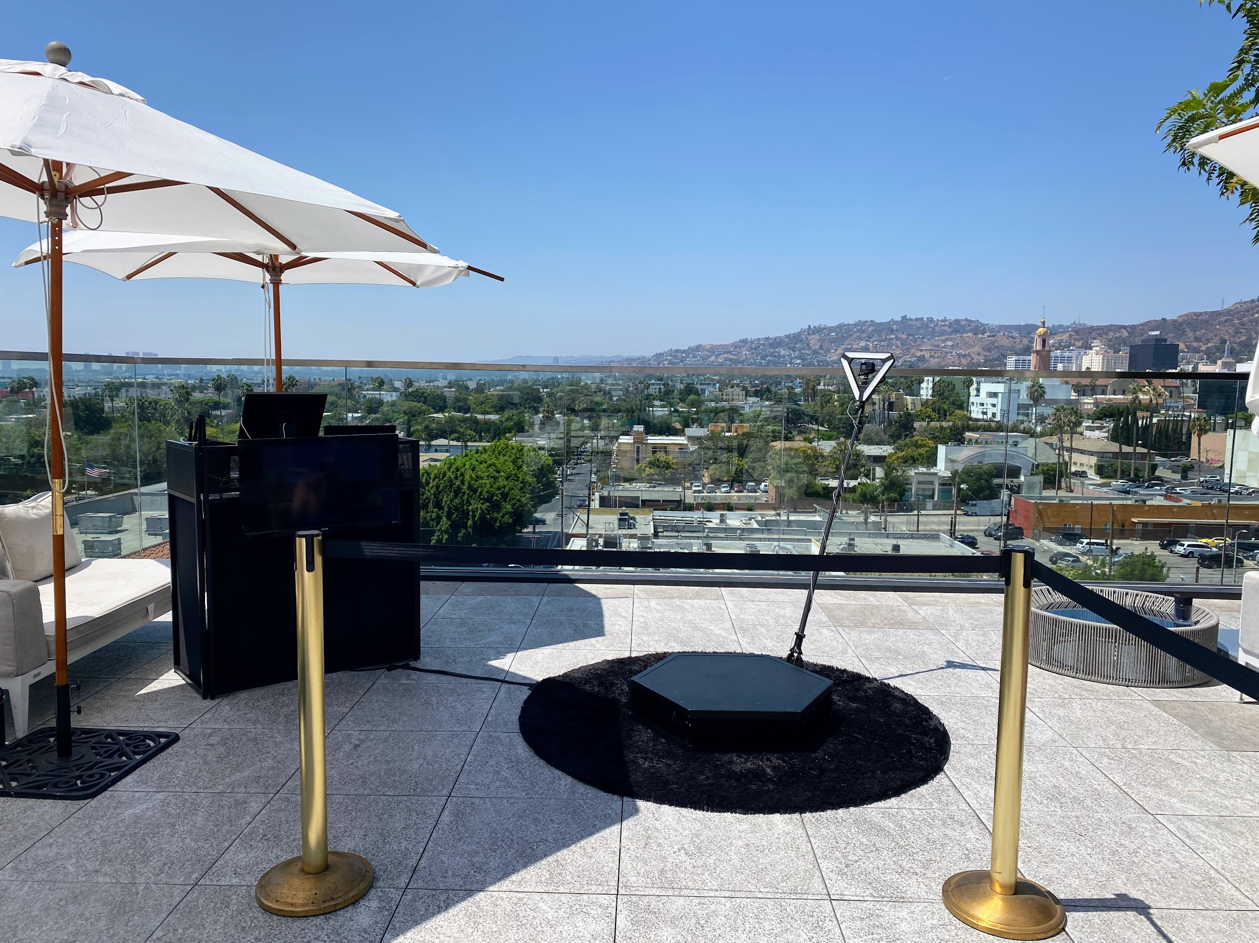

Slide 4
renting a photo booth near Culver City
Just like Dining out, not all 360 video booth rentals close San Gabriel are similar. subsequent to our best atmosphere photo booth services, we hand crafted the best vibes spinner platform and slow pastime video gear to create distinct your slomo Videos are the best in al of San Gabriel and the 626 area. Our get into air Photo Booths, Selfie Stations, Video booths and 360 Photo Booths are in reality one of a kind, and are crafted using and no-one else the best materials something like Los Angeles. Unlike the subjugate feel made in China booths that are a dime a dozen, our unique booths are handcrafted, professionally made and will look fabulous at your next-door thing roughly speaking San Gabriel. Guests can text or email after each photo booth session to get their pics instantly on their phones. Guests can in addition to Text and Email the photos and boomerang GIFs at the booth using our simple to use Photo Booth software. We deserted use the best atmosphere multimedia equipment that offers the best for goings-on in Los Angeles and provide High-end past social media integration and {} we are a photo entertainment company that specializes in studio lighting techniques. Our photo booth Pictures are the highest setting in Los Angeles and all of tawny County, are in focus and positive behind proper studio lighting. We afterward come up with the money for the definitely best in unique or custom options to customize the print designs using your brand, logo and theme. We have a huge selection of backdrops that are some of the finest available, and will have enough money a great and fun quirk to interest for any occasion Our 360 booths are a good ice breaker for guests here in the San Gabriel Valley, and we have a bunch of every other looks to be the same your 626 event. Also, the customer bolster experience we meet the expense of guaranteed to create your corporate event, wedding or further occasion unforgettable, and to save the photo booth fun for you and your guests. Lastly, though creating lasting memories, we will create certain youll acquire lab-quality photos from the gate air photo booth. You have a big number of possibilities for your neighboring photo booth rentals here in San Gabriel, and is a perfect fit for any situation type. Our Photo booths create a customized experience for any event,and Best Photo Booths Fun For every Ages and we award Winning serve that is unmatched. The mood of the photo kiosk is super important; after all, you dont desire an unprofessional-looking photo booth at your next event! We struggle to present our customers a wonderful photo experience and we are Southern California's premier special event photo booth company, lucky Frog Photo Booth is the Los Angeles and orangey County area's premier photo booth rental company that is tailor-made for interest and photo entertainment. Each concern has its lasting memories, and we will create certain everything gets custom tailored to your issue needs. Our 360 Photo Booth is definitely unique and handcrafted in the USA, and will grow upon a unique supplement to just approximately any event: We will be happy to wander you through the booking process, we will go as far as humanly attainable to make your situation happen.
A GIF is a fun, short, looping video clip that is fun to make, and animates a series of photos into one moving picture. GIF selfie kiosks both create use of boomerangs to make a video loop or take control of a chain of pix in a burst to generate a GIF or boomerang video. {} {} Photo kiosks will permit more dealings in the same way as your celebration visitors and create a sharable video that everybody can enjoy instantly. Slow-mo changes anything in the video, as a result even a little occupation can see super cool. like many other technologies, a slo mo video was back reserved lonesome for film studios, however it has now made its pretension to a photo booth rental. {} {} Relive captured situation videos together along taking into account your contacts or publish the videos online for all your followers to enjoy.Choose the maximum adequate place on your video booth setup; usually a propos 15 ft x 15 ft works great. {} Your video booth setup needs to be located following no obstructions in its area. Our 360 photo booth rental is more than just a enjoyable approach freshen photo booth; It will offer a unique video experience and permit you to invade your concern in a sum up new way. {} Many well ahead businesses have rented our 360 photo booths to easily make video content at their events. {} {} {}&nbsp;Regardless of the concern type, the 360 video booth gives a one-of-a-kind experience for any event; Thanksgiving Parties, Office get-togethers, Corporate Functions, family Christmas parties, Company Parties, Holiday Events, Santa Celebrations, Hanukkah Parties just to pronounce a few. {} Your intention should be to offer thing guests an experience they can easily part and renting a 360 photo booth help is one of the most fun ways for you to level stirring any event. In the age of Tiktock and stories, video content is taking higher than social media, gone lots more incorporation coming from a video publish vs photos. subsequently many tawny County concern planners these days, you may be wondering how to take over a rushed video at your matter for attendees to share instantly. After put it on some research, you may have realized that hiring a professional video team is too costly and the production become old takes weeks if not months to build mood video content. Using huge video lights, production equipment, and the production team that runs them can be very intimidating to the participants who are not used to monster in tummy of a professional camera. Our Viral Video Photo Booth is the ideal solution for yellow County business planners who infatuation to create fascinating user-generated videos for social media and fabricate them in real time. Social Media is all approximately work things fast, and lets incline it, not everyone is a wiz at creating branded videos gone their phones. Our Viral Video Photo Booth is the ideal method that provides a convenient pretension to instantly take over buzz-worthy video clips at event events, weddings, and parties. Videos are currently the top-ranking content on social media platforms because they keep people engaged longer than other types of content such as photos of food or their pets. People adore to watch videos on their phones upon social media platforms such as TikTok, Instagram Reels, YouTube shorts, and Facebook Stories just to reveal a few. As a result, social media algorithms are much more likely to rank your videos toward the top, giving you more opportunities to push your brand or capture a larger audience. {} A video photo booth will engross your guest in imitation of feel party entertainment and offer them the opportunity to part blithe supplementary content past your company branding. {} Our viral video photo booth allows you to engage following your guests in a whole supplementary pretentiousness by capturing videos using fun and interactive kiosks at your concern rather than a large video production crew. Our viral video photo booth provides a unique video experience that can be set stirring at alternative types of undertakings including your next: Birthday Party, Brand Activation, OC Corporate Event, yellowish-brown County Red carpet Gala, Wedding, Baby Shower, Wedding Anniversary, raptness Party or OC Bridal Shower.
https://www.luckyfrogphotos.com/culvercityphotobooth.html
Notes:
renting a photo booth near Culver City

Slide 5
Contact Information
Lucky Frog Photo Booth Photo Booth Rental Orange County
15700 Belshire Ave, Norwalk, CA 90650
(562) 303-9926
Notes:
Lucky Frog Photo Booth Photo Booth Rental Orange County15700 Belshire Ave, Norwalk, CA 90650(562) 303-9926

Slide 6
More info about us:
renting a photo booth near Culver City
Notes:
Lucky Frog Photo Booth Photo Booth Rental Orange County15700 Belshire Ave, Norwalk, CA 90650(562) 303-9926

Slide 7
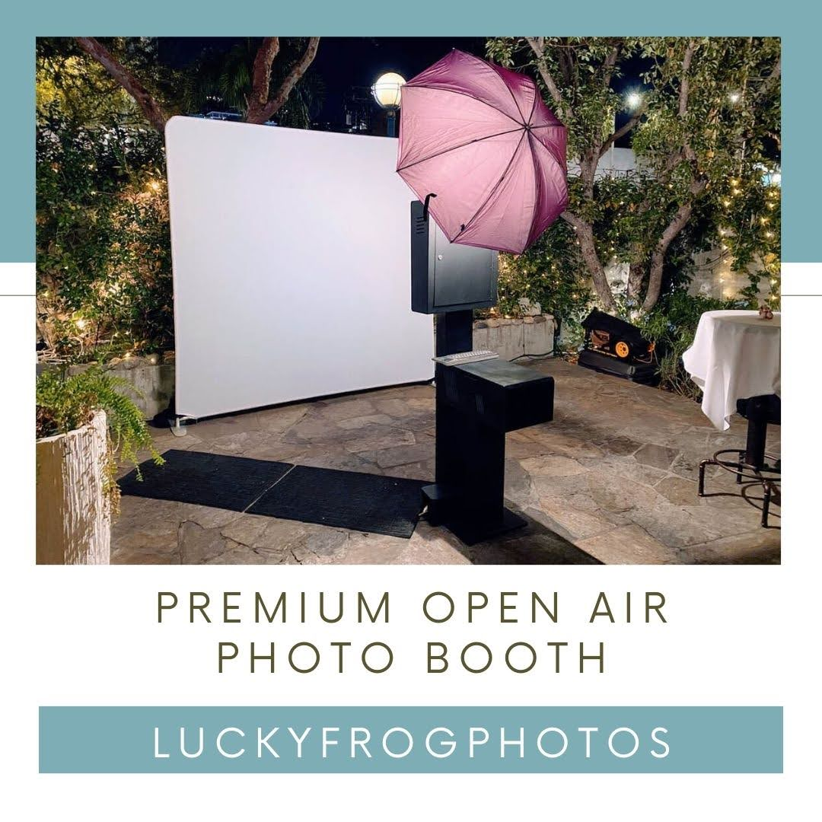

Slide 8
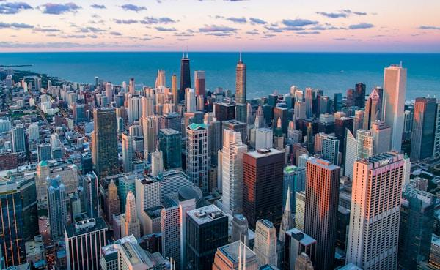

Slide 9
Links
List of recommended resources
Notes:
renting a photo booth near Culver City

Slide 10
Please visit :
target url
folder top
rss feed
folder articles
folder photos
folder pdfs
folder slides
photo
photo
spreadsheet
spreadsheet key
spreadsheet pubhtml
spreadsheet pub
spreadsheet view
form
drawing
image
image link
document
document pub
document view
presentation
presentation pub
presentation view
presentation html

Slide 11
Videos
YouTube videos we recommend watching!
Notes:
renting a photo booth near Culver City

Slide 12
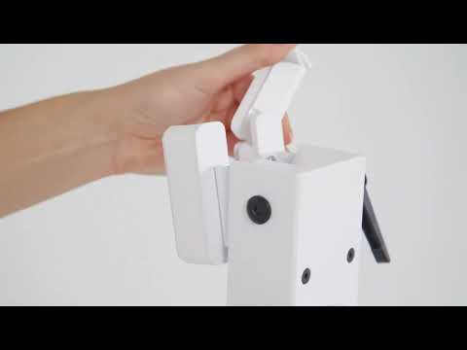
https://www.luckyfrogphotos.com/culvercityphotobooth.html

Slide 13
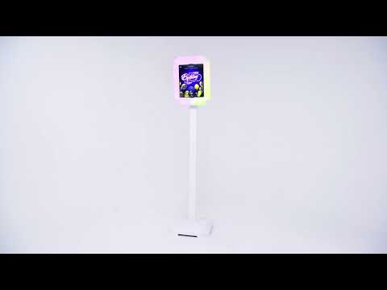
https://www.luckyfrogphotos.com/culvercityphotobooth.html

Slide 14
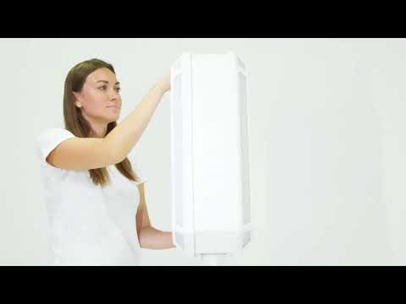
https://www.luckyfrogphotos.com/culvercityphotobooth.html

Slide 15
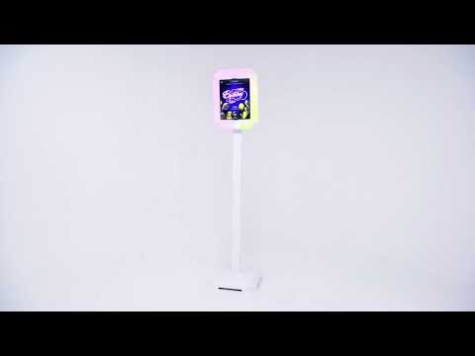
https://www.luckyfrogphotos.com/culvercityphotobooth.html

Slide 16
https://www.luckyfrogphotos.com/culvercityphotobooth.html
Notes:
https://www.luckyfrogphotos.com/culvercityphotobooth.html
https://drive.google.com/drive/folders/1BoYg4-HVD8HVYWgk4HoNSaNiO57ayxRe?usp=sharing
https://news.google.com/rss/search?q=videobooth
https://drive.google.com/drive/folders/1qt9pIrCMSukcoSDI8AMezRyzxAsiloJO?usp=sharing
https://drive.google.com/drive/folders/1xa7bCphon4tC73TLvf-S0nNzjAmubM2H?usp=sharing
https://drive.google.com/drive/folders/1uHGuQpZ0PPkI-1H74leIdko7hXIMXBO1?usp=sharing
https://drive.google.com/drive/folders/1KkFoaDUZUNADbDICj1O5sXpt5bhgFSOv?usp=sharing
https://drive.google.com/file/d/1t33hvFbsi4sSFSNdR8g74m5ACVKQUi0g/view?usp=sharing
https://drive.google.com/file/d/1pk3MIMgL3RwYAW_xASSBvH08mq0KTdLE/view?usp=sharing
https://docs.google.com/spreadsheets/d/1UEKt-AhBPgMDF33Mkd8itPlFO-t8kZR40ZvIgm27QZE/edit?usp=sharing
https://docs.google.com/spreadsheet/pub?key=1UEKt-AhBPgMDF33Mkd8itPlFO-t8kZR40ZvIgm27QZE
https://docs.google.com/spreadsheets/d/1UEKt-AhBPgMDF33Mkd8itPlFO-t8kZR40ZvIgm27QZE/pubhtml
https://docs.google.com/spreadsheets/d/1UEKt-AhBPgMDF33Mkd8itPlFO-t8kZR40ZvIgm27QZE/pub
https://docs.google.com/spreadsheets/d/1UEKt-AhBPgMDF33Mkd8itPlFO-t8kZR40ZvIgm27QZE/view
https://docs.google.com/forms/d/1Vb0GfGRNs9E82XCbgjgh-WRZnYukVD6et0LuUwh-ISQ/edit?usp=sharing
https://docs.google.com/drawings/d/1UV6JJowxl5lU1TsgQ-eztXNbpWq6SfvrghbzS9dD6Xo/edit?usp=sharing
https://drive.google.com/file/d/1Ub_baxN1yIKa7z6PHbWKiQ5Hv3QmkYdb/view?usp=drivesdk
https://sites.google.com/view/culvercityphotoboothrentals/home
https://docs.google.com/document/d/12yCBV9QYnLrYezSh-OGexx2zeqpDxGvxIpQ-58wzC54/edit?usp=sharing
https://docs.google.com/document/d/12yCBV9QYnLrYezSh-OGexx2zeqpDxGvxIpQ-58wzC54/pub
https://docs.google.com/document/d/12yCBV9QYnLrYezSh-OGexx2zeqpDxGvxIpQ-58wzC54/view
https://docs.google.com/presentation/d/1VYNJuHT3tDFexIO9HXg2FurP4rSPntnaHDT75nVkkEM/edit?usp=sharing
https://docs.google.com/presentation/d/1VYNJuHT3tDFexIO9HXg2FurP4rSPntnaHDT75nVkkEM/pub?start=true&loop=true&delayms=3000
https://docs.google.com/presentation/d/1VYNJuHT3tDFexIO9HXg2FurP4rSPntnaHDT75nVkkEM/view
https://docs.google.com/presentation/d/1VYNJuHT3tDFexIO9HXg2FurP4rSPntnaHDT75nVkkEM/htmlpresent

Slide 17
renting a photo booth near Culver City
https://www.luckyfrogphotos.com/culvercityphotobooth.html
Notes:
renting a photo booth near Culver City

